Slide 1
Smart Shopping
Cameron L’Ecuyer – Class ID: 17 (Team Leader)
Sneha Mishra – Class ID: 21
Navya Pillala – Class ID: 26
Ruthvic Punyamurtula – Class ID: 30

Slide 2
Application’s Purpose
Allow users to view clothes using augmented reality, so they can “try them on” before they buy them, or go to the store
Primary technologies:
Body recognition
Face recognition
BMI calculation
Searching of various stores using APIs
Android mobile platform

Slide 3
Increment 1
The primary function was to explore and implement technologies that we would need to create our app
Technologies:
Body recognition
Face recognition
BMI calculator
Image recognition
Retailer search APIs

Slide 4
Successes
We found and implemented APIs for facial recognition, body recognition, and image recognition
BMI was determined that it would be relatively easy to implement without an API

Slide 5
Issues
The facial API we started with was not sufficient, so a new one was found
None of the retailer APIs worked or were available to us
Several members of the team had to travel out of the country

Slide 6
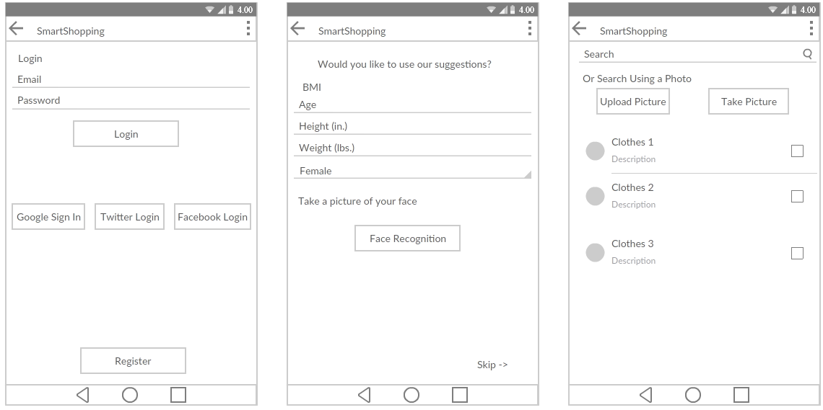
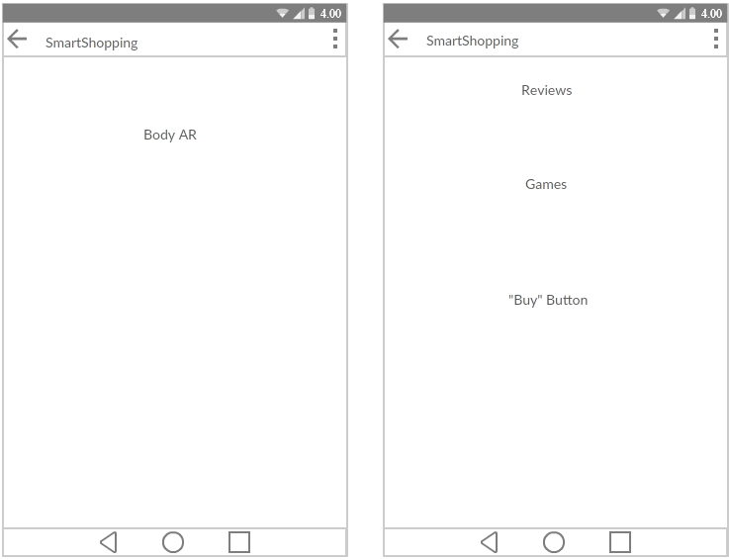
Increment 2 Goals
Integrate all the technologies together in Android
Create a static database for searching
Add more features to improve the app

